Slide 1
Embryology - development of Conotruncal region
Kshitij Mavade

Slide 2
Introduction
The Conus- also known as Infundibulum (Keith 1909)
The Conotruncus comprises collectively two myocardial sub segments,
BULBUS CORDIS –refers to the ventricular outflow tract
TRUNCUS ARTERIOSUS- embryologic precursor of great arteries.
-D A Goor (1972)

Slide 3
EARLY HEART

Slide 4
The truncus arteriosus, the most distal portion of the developing cardiac outflow tract, bordering on the overlying aortic sac, is the short segment that, once septated, allows the division of the common outflow orifice into two separate arterial valves orifice.
-Restivo et al (2006)

Slide 5
Restivo et al (2006)

Slide 6
Definitions
Conotruncus -The conotruncus is the outflow region of the developing heart. It consists of:
Conus- Inferior to the aortic and pulmonary valves .
Truncus- Superior to the valves that is continuous with the ventral aorta (aortic sac).

Slide 8
Bulbus cordis- also known as the conotruncus lies ventral to primitive ventricle.
Together with primitive ventricle it forms the ventricle of the formed heart.
The developing two main truncal cushions and the underlying two conal cushions are perfectly aligned and no line of demarcation between the two is identifiable in mammals
(Van Mierop and Patterson, 1980)

Slide 9
Secondary heart field
Area of the ventral pharyngeal mesoderm (Kelly et al, 2001; Mjaadvedt et al, 2001; Waldo et al, 2001) –
Pre cardiac Splanchnic Mesodermic -region providing myocardial precursor cells, which migrate to the Out flow Tract area of the developing cardiac tube, where they build up the Conotruncal myocardium as well as smooth muscle cells joining the caudal portion of the aortic sac (Waldo et al, 2005).

Slide 10
Secondary heart field
Part derives- part of right ventricle, & outflow tract (conus cordis & truncus arteriosus)
Field of cells appears slightly later (20-21days)
From splanchnic mesodermal, ventral to post. Pharynx
Resposible for lenghthning of outflow tract

Slide 11
Molecular aspect
SHF- expressed NKx2.5 and Gata4 transcriptio factors.
NKx2.5- and Gata4 SHF-committed cells join and incorporate themselves into the outflow tract of the primary heart tube, these cells undergo terminal myocardial differentiation under the induction of the local primary myocardial Bmp2 factor (Waldo et al 2001)

Slide 12
Other pathway involved
Wnt, fibroblast growth factor, bone morphogenetic protein, Hedgehog, and retinoic acid are all involved in signalling.
SHF contributes to the outflow tract (OFT), right ventricle, and inflow region

Slide 13
NEURAL CREST CELLS
Crest develops from - Dorsal neural tube. It overlaps the vagal neural crest and migrates to populate the pharyngeal arches 3, 4 and 6 (producing structures in the head) and to the heart, forming connective tissue that separates the great vessels of the heart.
Other Migration Locations: Pharyngeal arches and Truncus arteriosus , aorticopulmonary septum and the smooth muscle of great arteries.
Anterior of the aorta to become the four pre-aortic ganglia (celiac ganglion, superior mesenteric ganglion, inferior mesenteric ganglion and aortical renal ganglia)

Slide 14
Role of neural crest cells
Neural crest cells modulate the SHF cells.
It plays a role in elongation of the OFT.
Ablation of these cells cause failure of migration of SHF cells to conotruncus.
They provide the cells for entire conotruncal septum

Slide 15
Cardiac neural crest cells

Slide 16
Developement

Slide 17
Embryo – Aged 18-22 days

Slide 18
The heart tube is convoluted to forms five straight segments (limbs), and in-between them, four curves. The proximal segment of the heart tube (starting at the venous end) is the A-V
canal. It is oriented posteroanteriorly.
First curve or proximal bend- the heart tube makes a 90 degree turn toward the right to become the proximal transverse limb, or the interventricular foramen.
-DA GOOR

Slide 19
Curve 2 the heart tube makes a 90° turn cephalically to become the ascending limb .
Curve 3 the heart tube turns in 90degree medially to form the distal transverse limb.
Curve 4 the heart tube turns in 90degree toward the back of the embryo to form the terminal limb, which is cephalad and parallel to the A-V canal.
Each curve has a Greater and a Lesser curvature. The Lesser curvature of curve 2 is the Conoventricular Flange

Slide 21
Conotruncus and ostium bulbi
Border between meta ampulla and conus is the Ostium bulbi, or the conoventricular junction.
On the right the Ostium bulbi is the transition from the trabeculated ventricular endocardium to the smooth conal endocardium.
On the left the Ostium bulbi is lower edge of conoventricular flange.

Slide 22
Shift or rotation of ostium bulbi
Ostium bulbi shifts toward the left to cephalically and override the IVF. This critical process provides the conus with an access to the left ventricle.

Slide 23
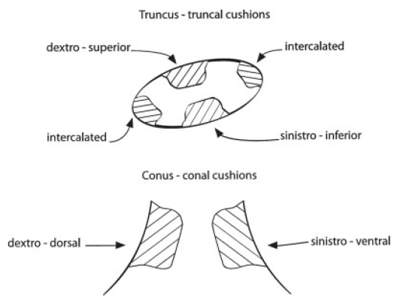
Truncal and conal cushions

Slide 24
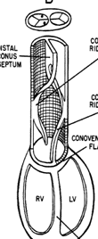
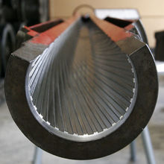
Conotruncal ridges
The conotruncal ridges are arranged in a spiral course, like riflings of a gun barrel.

Slide 25
Two main opposing dextrosuperior and sinistroinferior truncal endocardial cushions appear.
Occupying respectively a dorsal and a ventral oblique position, these cushions extend from the junction between the aortic sac and the truncus arteriosus down to the beginning of the conus, where they align with the dextrodorsal and sinistroventral conal cushions, respectively
-(Van Mierop and Patterson, 1980).

Slide 26
Aortic truncus
Pulmonary
truncus

Slide 27
Truncal rotation
The truncus rotates about 90-110° in a counterclockwise direction. This counterclockwise rotation (torsion) of the truncus, which follows the earlier counterclockwise rotation of the ostium bulbi, unwinds the coiled course of the conotruncal ridges .
As a result, the aortic truncus is transferred to the same side as the aortic conus (left side) and the aortic and pulmonary trunks become coiled, this situation is seen in the definitive heart.

Slide 28
Absorption of conus
Marked shortening of the conus and the equivalent lengthening of the aorta and pulmonary arteries.
The aortic conotruncus is reduced in length from 700 to 400 microns
The length of the pulmonary conotruncus is reduced from 880 microns to 600 microns
D A Goor et al

Slide 29
Absorption of the bilateral proximal conuses brought the distal conus septum toward the ventricular septum, and absorption of the distal aortic conus accounts for the fibrous continuity between the aortic and mitral valves.

Slide 30
The truncus is continuous distally with the aortic sac (ventral aorta) which is devoid of endocardial cushions.
At the same time, the septum aortopulmonale grows from the dorsal wall of the aortic sac toward the truncal septum to fuse with it. As a result of the fusion of these two septa the aortic sac is divided into the ascending aorta and the pulmonary artery .

Slide 31
Muscular elements arising from the right
ventricle invade the conus septum.
Once the conus septum is muscularized it receives the anatomic appearance of the crista supraventricularis.

Slide 32
Summarize
Effect of conus absorption-
1. “Migration“ of the distal conus septum toward the heart where it assumes its definitive position in the interventricular septum
2. Additional absorption of the distal aortic conus accounts for the fibrous continuity seen in the mature heart between the aortic and mitral valves

Slide 33
Inversion of conotruncus- 2 stages
Stage1 – Inversion of ostium bulbi at same time of looping
Stage 2- Rotation of truncus which occurs after the formation of septum aortopulmonale.
Ostium bulbar rotation causes the anatomic concordance between the left ventricle and the proximal aortic conus
Truncal torsion in similar manner and bring the semilunar valves to the same sides as their proximal conuses and unwinding the spiral course of the conotruncal ridges.

Slide 34
Basis for conotruncal defects
Ward et al. (2005) and Ward and Kirby (2006) emphasize that a short outflow tract,
through SHF ablation and through experimental ablation and with consequent low SHF cellular output to the conotruncal region, does not allow a normal conotruncal rotation.
PTA, tetralogy of Fallot (TF), pulmonary atresia with ventricular septal defect (VSD), and double-outlet right ventricle (DORV) as a consequence of the primary short conotruncal morphology.

Slide 35
Contd…
Myocardialisation of the ridges gives a zippering effect resulting in fusion.
Fusion occurs in a distal to proximal direction during the sixth week, allowing for cleavage of the aorta and pulmonary trunk.
The spiralling nature of the ridges causes the pulmonary trunk to twist around the aorta.

Slide 36
Conotruncal anomalies
TOF
DORV
TGA
PTA

Slide 37
TOF
Conal septum deviates anteriorly- faulty partition of conotruncal septum.
Abnormal conal rotation takes place
Malrotation of trunco-bulbar ridges causes misalignment of septum and straddling of aorta over VSD
Another mechanism-hypoplasia and under development of the pulmonary infundibulum causes infundibular hypoplasia.
Van Praagh et al {Amj Card 1970;26:25-33}

Slide 38
Truncus arteriosus
Due to incomplete or failed septation of the embryonic truncus arteriosus. Aortopulmonary and interventricular defects are believed to represent an abnormality of conotruncal septation.
Van Praagh {Amj Card 1965 ;16;406-425}

Slide 39
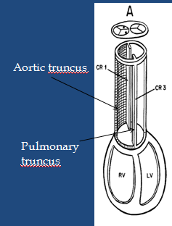
TGA
Arrest of both proximal & distal conal rotation lead to the transposition group of diseases, in which the aorta is dextroposed on the right side of the pulmonary artery & has no continuity with left ventricle
D A Goor et al

Slide 40
Contd..
Faulty absorption of the conus
Absent leftward shift of the conoventricular
junction account for the variability of transposition

Slide 41
DORV
Impaired morphogenesis of either the outflow portion (conotruncus) or the conoventricular flange
Abnormal connection between the muscular ventricular septum and the conus septum
And hence sub aortic flow path from right ventricle
Originally both vessels arise from RV and if no conoventricular shifting occurs then DORV
(Manner et al , Thorac cardiovasc surg 1995 )

Slide 42
THANK YOU

